Slide 1

First Findings on Current Drag and Incoherence in a Kelp Forest
By Jason Rooker
Dr. Derek Grimes
January 2026

Slide 2
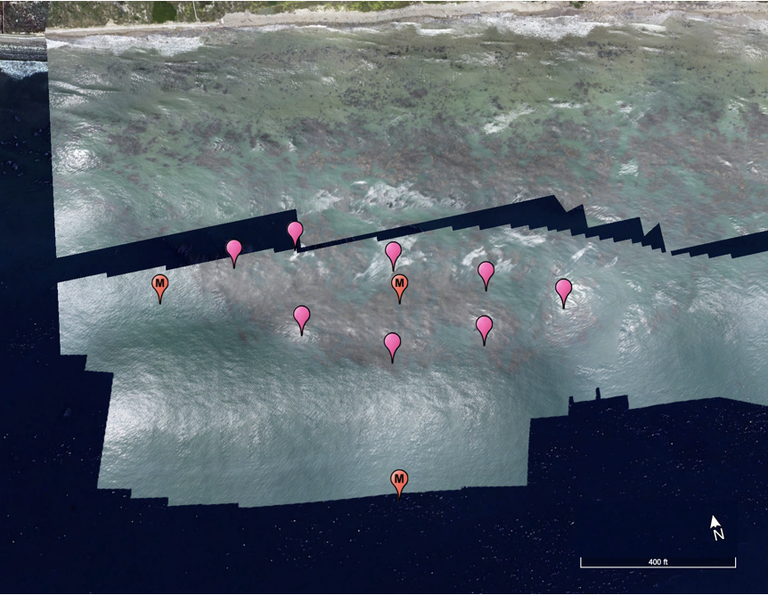
Moorings
Four ADCPs were used for this analysis.
2 x Signature 1000
AquaDopp 1Mhz
Vector
One Signature was located at M1, all others were near M2
M1
M2
Figure 1: Map of study area

Slide 3
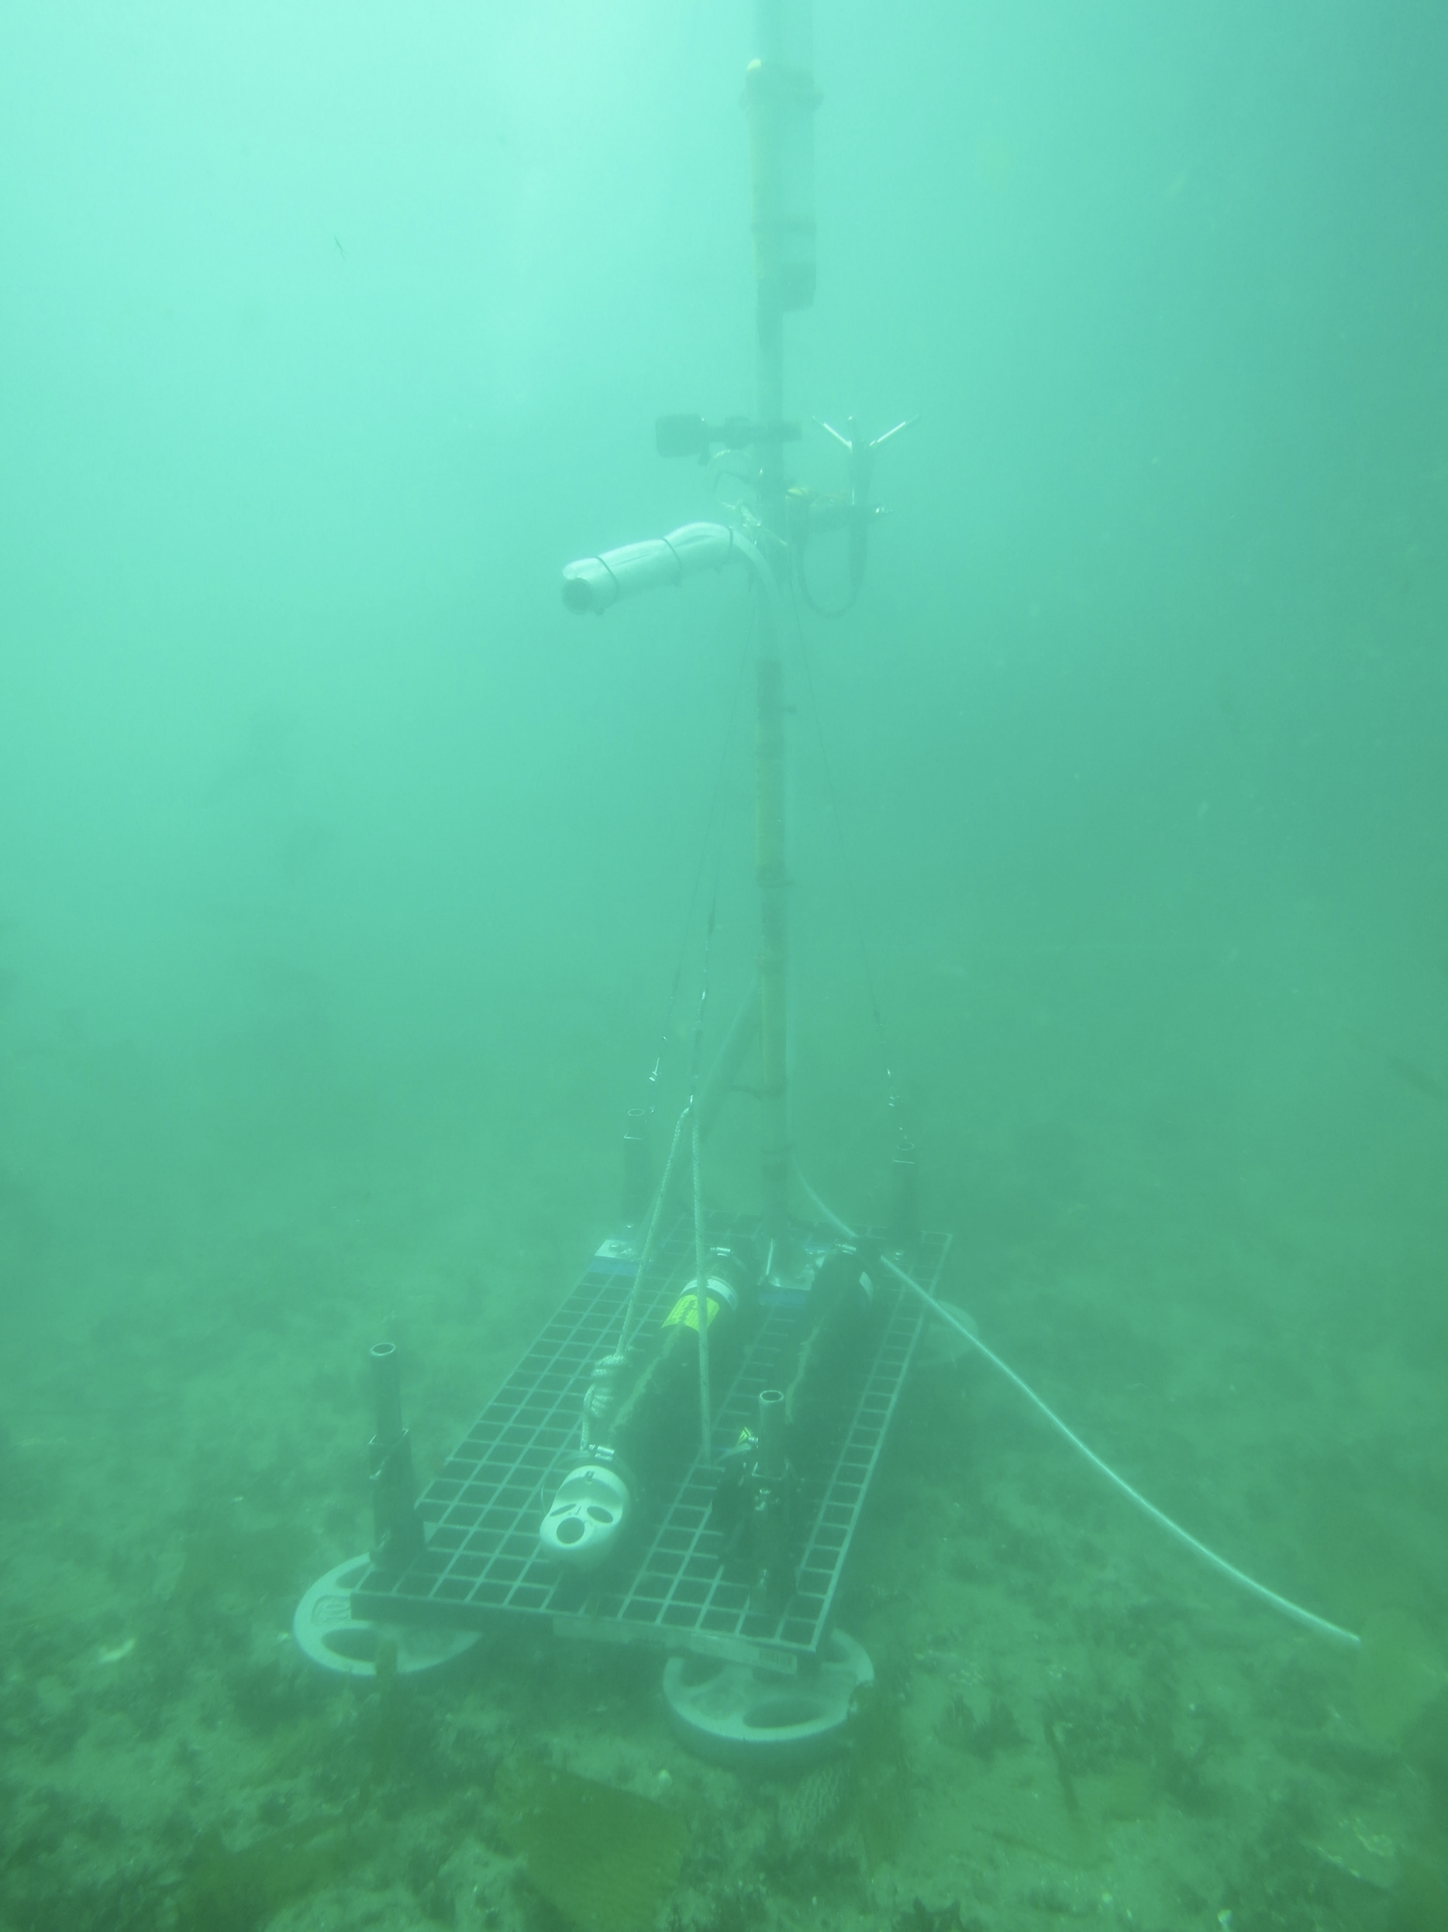
Sampling Height
Vector
The Vector is a point velocity sensor
All measurements from profilers were taken at the approximate height of the Vector sample point
1.2 meters
Figure 2: Two of the inside Instruments

Slide 4
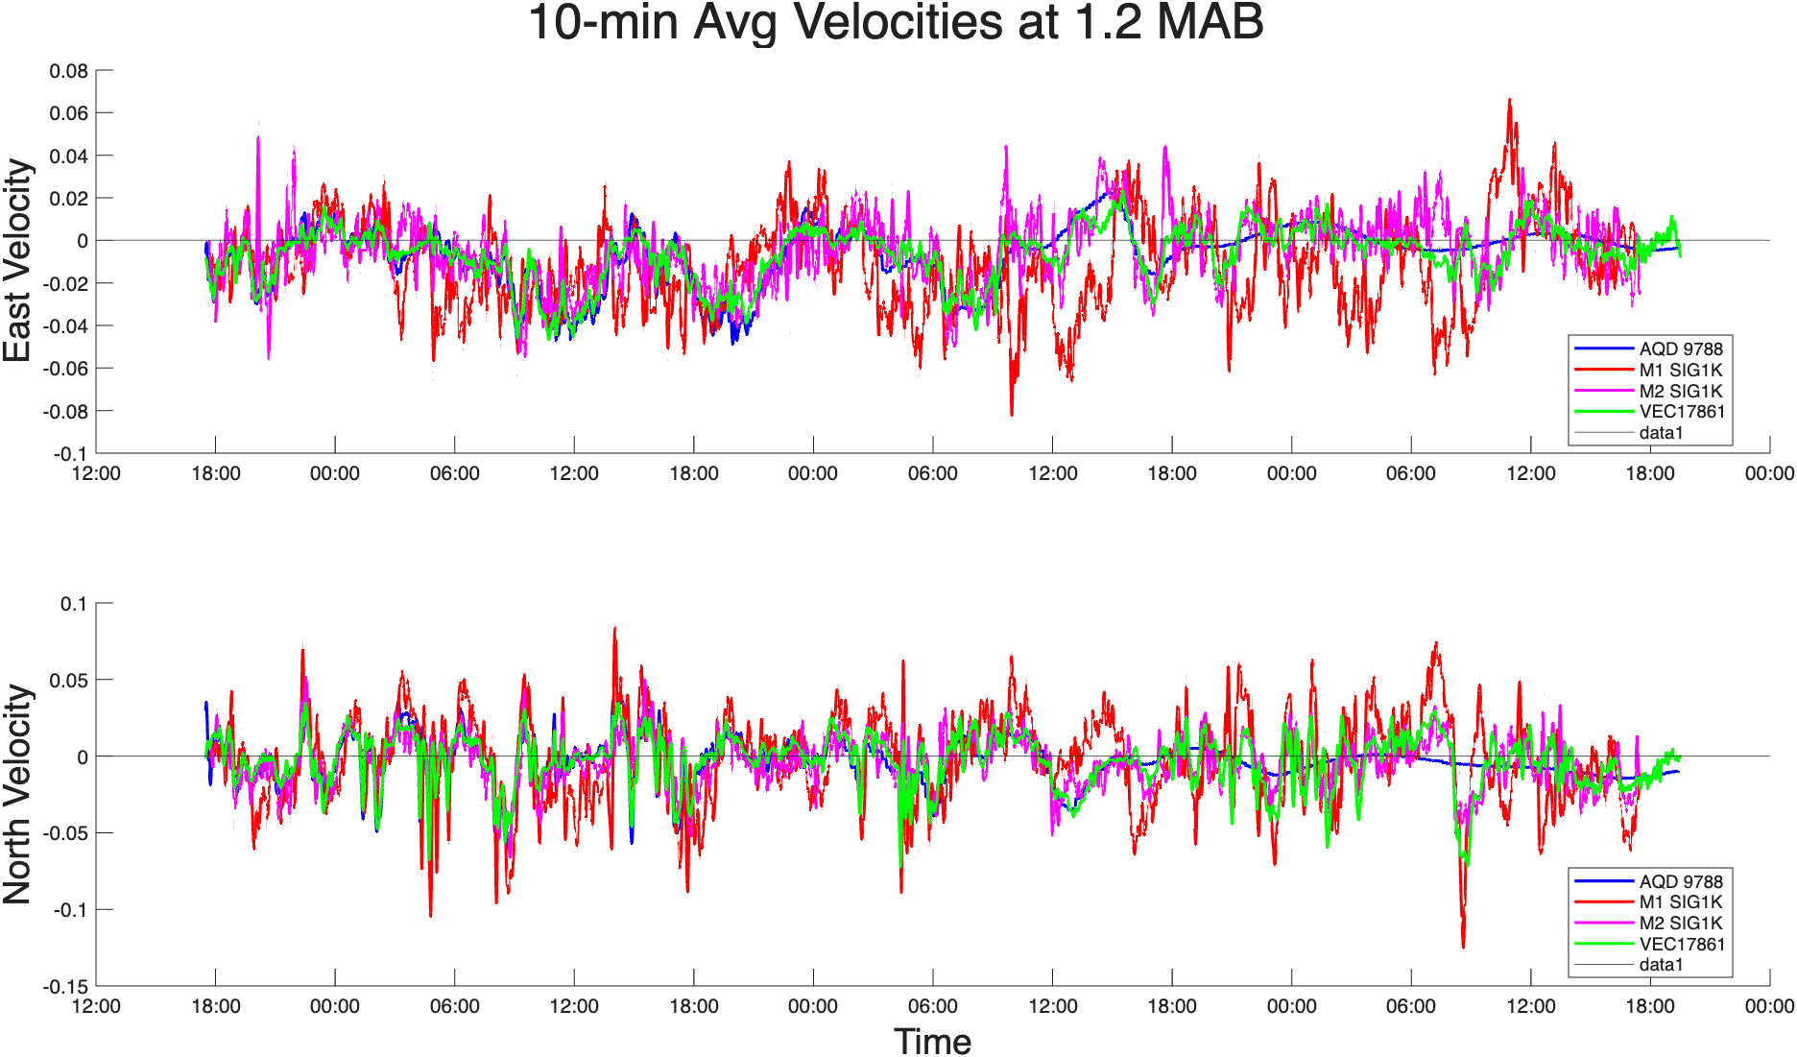
Low Pass Filter
The velocity signals were processed using a 10-minute Hamming window filter to remove noise and wave-level oscillations
Figure 3: Time-Series of each instrument’s filtered data

Slide 5
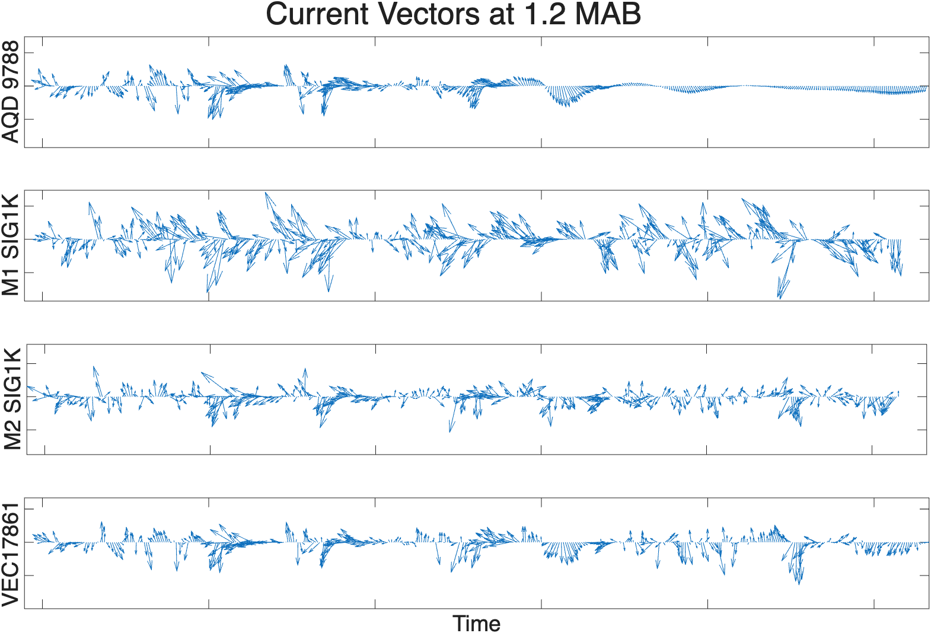
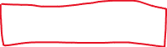
Coherence
Battery died here
All four ADCPs show similar trends in their currents, suggesting that the signals are subject to similar trends and do not have large phase differences
Figure 4: Directional Time-series

Slide 6
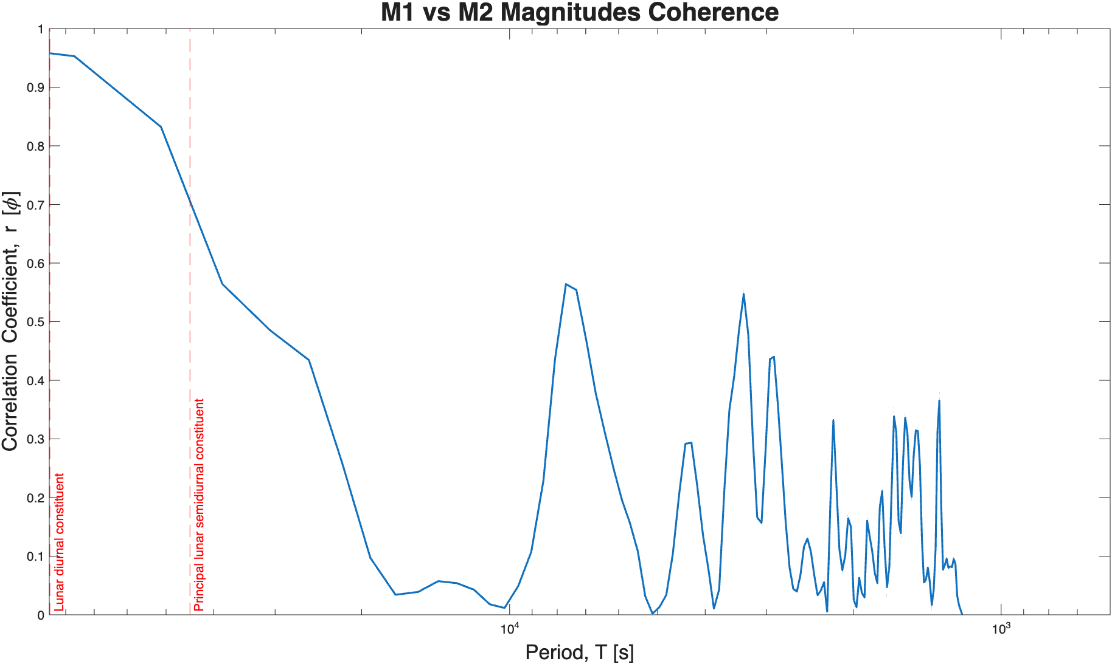
Coherence
Analysis of Coherence shows that the the two signals have low coherence except for very low frequency waves.
Figure 5: spectral coherence between the magnitude of M1 and M2 signals

Slide 7
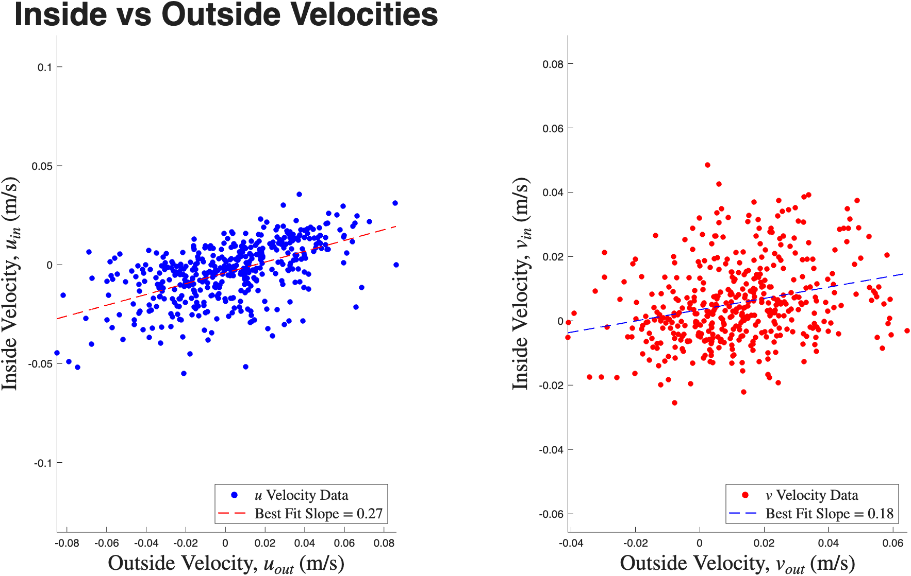
Velocity Reductions
This figure shows the velocities recorded outside against the velocities recorded inside. The flow velocity reduction factors are similar to those calculated in Rosman (2007)
Inside velocities are an arithmetic average of M2 Sig1k and Vector velocities. (AQD values were excluded because of battery issues)
“u” and “v” velocities are the major and minor principal components of variability and correspond approximately to North and East, respectively
Figure 6: Scatterplots of inside vs outside velocities

Slide 8
Supporting Code
LowPassFilter.m: Generates 10min filtered data (rotated to principal axes), figures 3 and 4
CalculateDrag.m: Compares arithmetic average of inside instruments to outside instrument. Generates figure 6
Attenuation.m: Script, generates figure 5
Pwd: Kelp_repo/AQR_Dye_Experiment/Rooker_GettingStarted/code

